Slide 1
CSC 2224: Parallel Computer Architecture and Programming Memory Hierarchy & Caches
Prof. Gennady Pekhimenko
University of Toronto
Fall 2020
The content of this lecture is adapted from the lectures of
Onur Mutlu @ CMU and ETH

Slide 2
Reviews: Cache Compression
Review:
Pekhimenko et al., “Base-Delta-Immediate Compression: Practical Data Compression for On-Chip Caches,” PACT 2012

Slide 3
Project Proposal Deadline
Deadline is on October 1st
Send emails with your proposals (PDFs) to csc2224arch@gmail.com

Slide 4
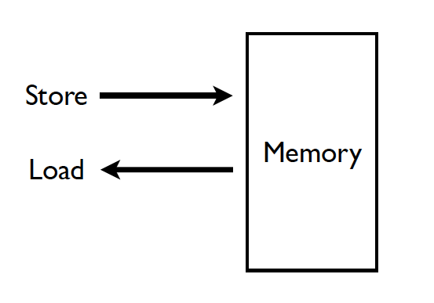
Memory (Programmer’s View)

Slide 5
Virtual vs. Physical Memory
Programmer sees virtual memory
Can assume the memory is “infinite”
Reality: Physical memory size is much smaller than what the programmer assumes
The system (system software + hardware, cooperatively) maps virtual memory addresses to physical memory
The system automatically manages the physical memory space transparently to the programmer
+ Programmer does not need to know the physical size of memory nor manage it → A small physical memory can appear as a huge one to the programmer → Life is easier for the programmer
-- More complex system software and architecture
A classic example of the programmer/(micro)architect tradeoff

Slide 6
(Physical) Memory System
You need a larger level of storage to manage a small amount of physical memory automatically
→ Physical memory has a backing store: disk
We will first start with the physical memory system
For now, ignore the virtual → physical indirection
We will get back to it when the needs of virtual memory start complicating the design of physical memory…

Slide 7
Idealism
Pipeline
(Instruction
execution)
Instruction
Supply
Data
Supply
- Zero latency access
- Infinite capacity
- Zero cost
- Perfect control flow
No pipeline stalls
Perfect data flow
(reg/memory dependencies)
Zero-cycle interconnect
(operand communication)
Enough functional units
Zero latency compute
Zero latency access
Infinite capacity
- Infinite bandwidth
Zero cost

Slide 8
The Memory Hierarchy

Slide 9
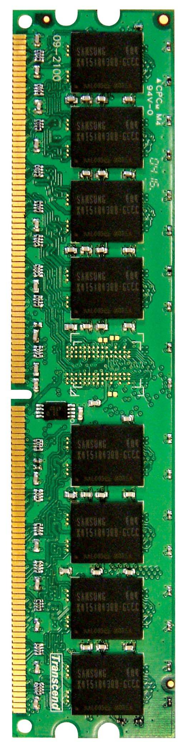
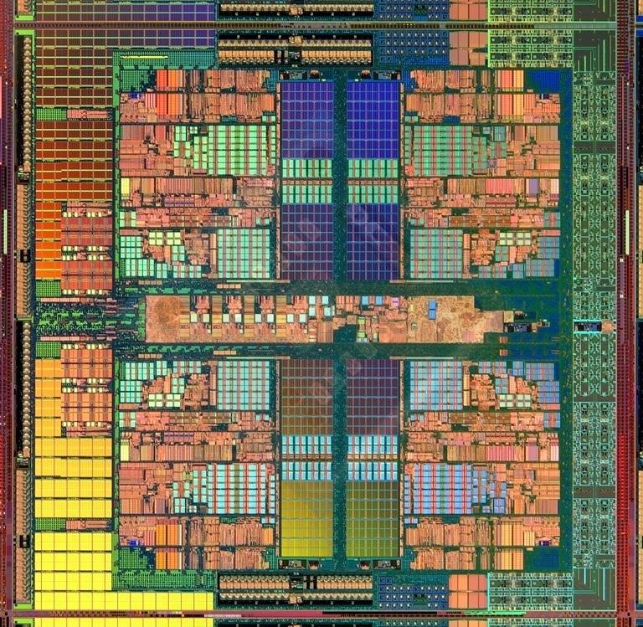
Memory in a Modern System
CORE 0
L2 CACHE 1
CORE 1
L2 CACHE 0
SHARED L3 CACHE
DRAM INTERFACE
DRAM MEMORY CONTROLLER
DRAM BANKS
L2 CACHE 2
CORE 3
CORE 2
L2 CACHE 3

Slide 10
Ideal Memory
Zero access time (latency)
Infinite capacity
Zero cost
Infinite bandwidth (to support multiple accesses in parallel)

Slide 11
The Problem
Ideal memory’s requirements oppose each other
Bigger is slower
Bigger → Takes longer to determine the location
Faster is more expensive
Memory technology: SRAM vs. DRAM vs. Disk vs. Tape
Higher bandwidth is more expensive
Need more banks, more ports, higher frequency, or faster technology

Slide 12
Memory Technology: DRAM
Dynamic random access memory
Capacitor charge state indicates stored value
Whether the capacitor is charged or discharged indicates storage of 1 or 0
1 capacitor
1 access transistor
Capacitor leaks through the RC path
DRAM cell loses charge over time
DRAM cell needs to be refreshed
row enable
_bitline

Slide 13
Memory Technology: SRAM
Static random access memory
Two cross coupled inverters store a single bit
Feedback path enables the stored value to persist in the “cell”
4 transistors for storage
2 transistors for access
row select
bitline
_bitline

Slide 14
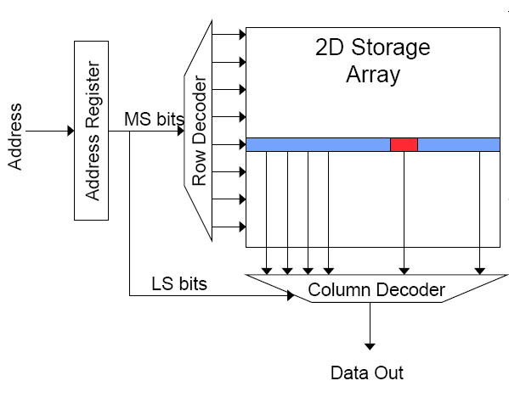
Memory Bank Organization and Operation
Read access sequence:
1. Decode row address & drive word-lines
2. Selected bits drive bit-lines
• Entire row read
3. Amplify row data
4. Decode column address & select subset of row
• Send to output
5. Precharge bit-lines
• For next access

Slide 15
SRAM (Static Random Access Memory)
Read Sequence
1. address decode
2. drive row select
3. selected bit-cells drive bitlines
(entire row is read together)
4. differential sensing and column select
(data is ready)
5. precharge all bitlines
(for next read or write)
Access latency dominated by steps 2 and 3
Cycling time dominated by steps 2, 3 and 5
step 2 proportional to 2^{m}
step 3 and 5 proportional to 2^{n}
row select
bitline
_bitline
bit-cell array
2^{n} row x 2^{m}-col
(n≈m to minimize
overall latency)
n+m
n
2^{n}
m
2^{m} diff pairs
sense amp and mux
1

Slide 16
DRAM (Dynamic Random Access Memory)
Bits stored as charges on node capacitance (non-restorative)
bit cell loses charge when read
bit cell loses charge over time
Read Sequence
1~3 same as SRAM
4. a “flip-flopping” sense amp amplifies and regenerates the bitline, data bit is mux’ed out
5. precharge all bitlines
Destructive reads
Charge loss over time
Refresh: A DRAM controller must periodically read each row within the allowed refresh time (10s of ms) such that charge is restored
row enable
_bitline
RAS
bit-cell array
2^{n} row x 2^{m}-col
(n≈m to minimize
overall latency)
n
2^{n}
m
2^{m}
sense amp and mux
1
A DRAM die comprises
of multiple such arrays
CAS

Slide 17
DRAM vs. SRAM
DRAM
Slower access (capacitor)
Higher density (1T 1C cell)
Lower cost
Requires refresh (power, performance, circuitry)
Manufacturing requires putting capacitor and logic together
SRAM
Faster access (no capacitor)
Lower density (6T cell)
Higher cost
No need for refresh
Manufacturing compatible with logic process (no capacitor)

Slide 18
The Problem (data from 2011)
Bigger is slower
SRAM, 512 Bytes, sub-nanosec
SRAM, KByte~MByte, ~nanosec
DRAM, Gigabyte, ~50 nanosec
Hard Disk, Terabyte, ~10 millisec
Faster is more expensive (dollars and chip area)
SRAM, < 10$ per Megabyte
DRAM, < 1$ per Megabyte
Hard Disk < 1$ per Gigabyte
These sample values (circa ~2011) scale with time
Other technologies have their place as well
Flash memory, PC-RAM, MRAM, RRAM (not mature yet)

Slide 19
The Problem (Modern)
Faster is more expensive (dollars and chip area)
SRAM, $5000 per GB
DRAM, < $100 per GB
SSD, < $0.50 per GB
Hard Disk < $0.04 per GB
NVDIMM < $10 per GB

Slide 20
Why Memory Hierarchy?
We want both fast and large
But we cannot achieve both with a single level of memory
Idea: Have multiple levels of storage (progressively bigger and slower as the levels are farther from the processor) and ensure most of the data the processor needs is kept in the fast(er) level(s)

Slide 21
The Memory Hierarchy
move what you use here
fast
small
With good locality of reference, memory appears as fast as
and as large as
faster per byte
cheaper per byte
backup
everything
here
big but slow

Slide 22
Memory Hierarchy
Fundamental tradeoff
Fast memory: small
Large memory: slow
Idea: Memory hierarchy
Latency, cost, size,
bandwidth
Hard Disk
Main
Memory
(DRAM)
CPU
Cache
RF

Slide 23
Locality
One’s recent past is a very good predictor of his/her near future.
Temporal Locality: If you just did something, it is very likely that you will do the same thing again soon
since you are here today, there is a good chance you will be here again and again regularly
Spatial Locality: If you did something, it is very likely you will do something similar/related (in space)
every time I find you in this room, you are probably sitting close to the same people

Slide 24
Memory Locality
A “typical” program has a lot of locality in memory references
typical programs are composed of “loops”
Temporal: A program tends to reference the same memory location many times and all within a small window of time
Spatial: A program tends to reference a cluster of memory locations at a time
most notable examples:
1. instruction memory references
2. array/data structure references

Slide 25
Caching Basics: Exploit Temporal Locality
Idea: Store recently accessed data in automatically managed fast memory (called cache)
Anticipation: the data will be accessed again soon
Temporal locality principle
Recently accessed data will be again accessed in the near future
This is what Maurice Wilkes had in mind:
Wilkes, “Slave Memories and Dynamic Storage Allocation,” IEEE Trans. On Electronic Computers, 1965.
“The use is discussed of a fast core memory of, say 32000 words as a slave to a slower core memory of, say, one million words in such a way that in practical cases the effective access time is nearer that of the fast memory than that of the slow memory.”

Slide 26
Caching Basics: Exploit Spatial Locality
Idea: Store addresses adjacent to the recently accessed one in automatically managed fast memory
Logically divide memory into equal size blocks
Fetch to cache the accessed block in its entirety
Anticipation: nearby data will be accessed soon
Spatial locality principle
Nearby data in memory will be accessed in the near future
E.g., sequential instruction access, array traversal
This is what IBM 360/85 implemented
16 Kbyte cache with 64 byte blocks
Liptay, “Structural aspects of the System/360 Model 85 II: the cache,” IBM Systems Journal, 1968.

Slide 27
The Bookshelf Analogy
Book in your hand
Desk
Bookshelf
Boxes at home
Boxes in storage
Recently-used books tend to stay on desk
Comp Arch books, books for classes you are currently taking
Until the desk gets full
Adjacent books in the shelf needed around the same time
If I have organized/categorized my books well in the shelf

Slide 28
Caching in a Pipelined Design
The cache needs to be tightly integrated into the pipeline
Ideally, access in 1-cycle so that dependent operations do not stall
High frequency pipeline → Cannot make the cache large
But, we want a large cache AND a pipelined design
Idea: Cache hierarchy
Main
Memory
(DRAM)
Level 2
Cache
CPU
Level1
Cache
RF

Slide 29
A Note on Manual vs. Automatic Management
Manual: Programmer manages data movement across levels
-- too painful for programmers on substantial programs
“core” vs “drum” memory in the 50’s
still done in some embedded processors (on-chip scratch pad SRAM in lieu of a cache) and GPUs (called “shared memory”)
Automatic: Hardware manages data movement across levels, transparently to the programmer
++ programmer’s life is easier
the average programmer doesn’t need to know about it
You don’t need to know how big the cache is and how it works to write a “correct” program! (What if you want a “fast” program?)

Slide 30
A Modern Memory Hierarchy
Register File
32 words, sub-nsec
L1 cache
~32 KB, ~nsec
L2 cache
512 KB ~ 1MB, many nsec
L3 cache,
.....
Main memory (DRAM),
GB, ~100 nsec
Swap Disk
100 GB, ~10 msec
manual/compiler
register spilling
Memory
Abstraction
Automatic
HW cache
management
automatic
demand
paging

Slide 31
Hierarchical Latency Analysis
For a given memory hierarchy level i it has a technology-intrinsic access time of t_{i,} The perceived access time T_{i} is longer than t_{i}
Except for the outer-most hierarchy, when looking for a given address there is
a chance (hit-rate h_{i}) you “hit” and access time is t_{i}
a chance (miss-rate m_{i}) you “miss” and access time t_{i} +T_{i+1}
h_{i} + m_{i} = 1
Thus
T_{i} = h_{i}·t_{i} + m_{i}·(t_{i} + T_{i+1})
T_{i} = t_{i} + m_{i} ·T_{i+1}
h_{i} and m_{i} are defined to be the hit-rate
and miss-rate of just the references that missed at L_{i-1}

Slide 32
Hierarchy Design Considerations
Recursive latency equation
T_{i} = t_{i} + m_{i} ·T_{i+1}
The goal: achieve desired T₁ within allowed cost
T_{i} ≈ t_{i} is desirable
Keep m_{i} low
increasing capacity C_{i} lowers m_{i}, but beware of increasing t_{i}
lower m_{i} by smarter management (replacement::anticipate what you don’t need, prefetching::anticipate what you will need)
Keep T_{i+1} low
faster lower hierarchies, but beware of increasing cost
introduce intermediate hierarchies as a compromise

Slide 33
Intel Pentium 4 Example
90nm P4, 3.6 GHz
L1 D-cache
C₁ = 16K
t₁ = 4 cyc int / 9 cycle fp
L2 D-cache
C₂ =1024 KB
t₂ = 18 cyc int / 18 cyc fp
Main memory
t₃ = ~ 50ns or 180 cyc
Notice
best case latency is not 1
worst case access latencies are into 500+ cycles
if m₁=0.1, m₂=0.1
T₁=7.6, T₂=36
if m₁=0.01, m₂=0.01
T₁=4.2, T₂=19.8
if m₁=0.05, m₂=0.01
T₁=5.00, T₂=19.8
if m₁=0.01, m₂=0.50
T₁=5.08, T₂=108

Slide 34
Cache Basics and Operation

Slide 35
Cache
Generically, any structure that “memoizes” frequently used results to avoid repeating the long-latency operations required to reproduce the results from scratch, e.g. a web cache
Most commonly in the on-die context: an automatically-managed memory hierarchy based on SRAM
memoize in SRAM the most frequently accessed DRAM memory locations to avoid repeatedly paying for the DRAM access latency

Slide 36
Caching Basics
Block (line): Unit of storage in the cache
Memory is logically divided into cache blocks that map to locations in the cache
On a reference:
HIT: If in cache, use cached data instead of accessing memory
MISS: If not in cache, bring block into cache
Maybe have to kick something else out to do it
Some important cache design decisions
Placement: where and how to place/find a block in cache?
Replacement: what data to remove to make room in cache?
Granularity of management: large or small blocks? Subblocks?
Write policy: what do we do about writes?
Instructions/data: do we treat them separately?

Slide 37
Cache Abstraction and Metrics
Cache hit rate = (# hits) / (# hits + # misses) = (# hits) / (# accesses)
Average memory access time (AMAT)
= ( hit-rate * hit-latency ) + ( miss-rate * miss-latency )
Aside: Can reducing AMAT reduce performance?
Address
Tag Store
(is the address
in the cache?
+ bookkeeping)
Data Store
(stores
memory
blocks)
Hit/miss?
Data

Slide 38
A Basic Hardware Cache Design
We will start with a basic hardware cache design
Then, we will examine a multitude of ideas to make it better

Slide 39
Blocks and Addressing the Cache
Memory is logically divided into fixed-size blocks
Each block maps to a location in the cache, determined by the index bits in the address
used to index into the tag and data stores
Cache access:
1) index into the tag and data stores with index bits in address
2) check valid bit in tag store
3) compare tag bits in address with the stored tag in tag store
If a block is in the cache (cache hit), the stored tag should be valid and match the tag of the block
tag
index
byte in block
2b
3 bits
3 bits
8-bit address

Slide 40
Direct-Mapped Cache: Placement and Access
Assume byte-addressable memory: 256 bytes, 8-byte blocks → 32 blocks
Assume cache: 64 bytes, 8 blocks
Direct-mapped: A block can go to only one location
Addresses with same index contend for the same location: Cause conflict misses
tag
index
byte in block
2b
3 bits
3 bits
Tag store
Data store
Address
V
tag
=?
MUX
byte in block
Hit?
Data

Slide 41
Direct-Mapped Caches
Direct-mapped cache: Two blocks in memory that map to the same index in the cache cannot be present in the cache at the same time
One index → one entry
Can lead to 0% hit rate if more than one block accessed in an interleaved manner map to the same index
Assume addresses A and B have the same index bits but different tag bits
A, B, A, B, A, B, A, B, … → conflict in the cache index
All accesses are conflict misses

Slide 42
Set Associativity
Addresses 0 and 8 always conflict in direct mapped cache
Instead of having one column of 8, have 2 columns of 4 blocks
Tag store
Data store
SET
V
tag
V
tag
=?
=?
MUX
Logic
MUX
byte in block
Address
Hit?
tag
index
byte in block
Key idea: Associative memory within the set
+ Accommodates conflicts better (fewer conflict misses)
-- More complex, slower access, larger tag store
3b
2 bits
3 bits

Slide 43
Higher Associativity
4-way
+ Likelihood of conflict misses even lower
-- More tag comparators and wider data mux; larger tags
Tag store
=?
=?
=?
=?
Logic
Hit?
Data store
MUX
MUX
byte in block

Slide 44
Full Associativity
Fully associative cache
A block can be placed in any cache location
Tag store
=?
=?
=?
=?
=?
=?
=?
=?
Logic
Hit?
Data store
MUX
MUX
byte in block

Slide 45
Associativity (and Tradeoffs)
Degree of associativity: How many blocks can map to the same index (or set)?
Higher associativity
++ Higher hit rate
-- Slower cache access time
(hit latency and data access latency)
-- More expensive hardware
(more comparators)
Diminishing returns from
higher associativity
hit rate
associativity

Slide 46
Issues in Set-Associative Caches
Think of each block in a set having a “priority”
Indicating how important it is to keep the block in the cache
Key issue: How do you determine/adjust block priorities?
There are three key decisions in a set:
Insertion, promotion, eviction (replacement)
Insertion: What happens to priorities on a cache fill?
Where to insert the incoming block, whether or not to insert the block
Promotion: What happens to priorities on a cache hit?
Whether and how to change block priority
Eviction/replacement: What happens to priorities on a cache miss?
Which block to evict and how to adjust priorities

Slide 47
Eviction/Replacement Policy
Which block in the set to replace on a cache miss?
Any invalid block first
If all are valid, consult the replacement policy
Random
FIFO
Least recently used (how to implement?)
Not most recently used
Least frequently used?
Least costly to re-fetch?
Why would memory accesses have different cost?
Hybrid replacement policies
Optimal replacement policy?

Slide 48
Implementing LRU
Idea: Evict the least recently accessed block
Problem: Need to keep track of access ordering of blocks
Question: 2-way set associative cache:
What do you need to implement LRU perfectly?
Question: 4-way set associative cache:
What do you need to implement LRU perfectly?
How many different orderings possible for the 4 blocks in the set?
How many bits needed to encode the LRU order of a block?
What is the logic needed to determine the LRU victim?

Slide 49
Approximations of LRU
Most modern processors do not implement “true LRU” (also called “perfect LRU”) in highly-associative caches
Why?
True LRU is complex
LRU is an approximation to predict locality anyway (i.e., not the best possible cache management policy)
Examples:
Not MRU (not most recently used)
Hierarchical LRU: divide the N-way set into M “groups”, track the MRU group and the MRU way in each group
Victim-NextVictim Replacement: Only keep track of the victim and the next victim

Slide 50
Hierarchical LRU (not MRU)
Divide a set into multiple groups
Keep track of only the MRU group
Keep track of only the MRU block in each group
On replacement, select victim as:
A not-MRU block in one of the not-MRU groups (randomly pick one of such blocks/groups)

Slide 51
Cache Replacement Policy: LRU or Random
LRU vs. Random: Which one is better?
Example: 4-way cache, cyclic references to A, B, C, D, E
0% hit rate with LRU policy
Set thrashing: When the “program working set” in a set is larger than set associativity
Random replacement policy is better when thrashing occurs
In practice:
Depends on workload
Average hit rate of LRU and Random are similar
Best of both Worlds: Hybrid of LRU and Random
How to choose between the two? Set sampling
See Qureshi et al., “A Case for MLP-Aware Cache Replacement,“ ISCA 2006.

Slide 52
What Is the Optimal?
Belady’s OPT
Replace the block that is going to be referenced furthest in the future by the program
Belady, “A study of replacement algorithms for a virtual-storage computer,” IBM Systems Journal, 1966.
How do we implement this? Simulate?
Is this optimal for minimizing miss rate?
Is this optimal for minimizing execution time?
No. Cache miss latency/cost varies from block to block!
Two reasons: Remote vs. local caches and miss overlapping
Qureshi et al. “A Case for MLP-Aware Cache Replacement,“ ISCA 2006.

Slide 53
What’s In A Tag Store Entry?
Valid bit
Tag
Replacement policy bits
Dirty bit?
Write back vs. write through caches

Slide 54
Handling Writes (I)
When do we write the modified data in a cache to the next level?
Write through: At the time the write happens
Write back: When the block is evicted
Write-back
+ Can combine multiple writes to the same block before eviction
Potentially saves bandwidth between cache levels + saves energy
-- Need a bit in the tag store indicating the block is “dirty/modified”
Write-through
+ Simpler
+ All levels are up to date. Consistency: Simpler cache coherence because no need to check close-to-processor caches’ tag stores for presence
-- More bandwidth intensive; no combining of writes

Slide 55
Handling Writes (II)
Do we allocate a cache block on a write miss?
Allocate on write miss: Yes
No-allocate on write miss: No
Allocate on write miss
+ Can combine writes instead of writing each of them individually to next level
+ Simpler because write misses can be treated the same way as read misses
-- Requires (?) transfer of the whole cache block
No-allocate
+ Conserves cache space if locality of writes is low (potentially better cache hit rate)

Slide 56
Handling Writes (III)
What if the processor writes to an entire block over a small amount of time?
Is there any need to bring the block into the cache from memory in the first place?
Ditto for a portion of the block, i.e., subblock
E.g., 4 bytes out of 64 bytes

Slide 57
Cache Performance

Slide 58
Cache Parameters vs. Miss/Hit Rate
Cache size
Block size
Associativity
Replacement policy
Insertion/Placement policy

Slide 59
Cache Size
Cache size: total data (not including tag) capacity
bigger can exploit temporal locality better
not ALWAYS better
Too large a cache adversely affects hit and miss latency
smaller is faster => bigger is slower
access time may degrade critical path
Too small a cache
doesn’t exploit temporal locality well
useful data replaced often
Working set: the whole set of data the executing application references
Within a time interval
hit rate
“working set”
size
cache size

Slide 60
Block Size
Block size is the data that is associated with an address tag
not necessarily the unit of transfer between hierarchies
Sub-blocking: A block divided into multiple pieces (each with V bit)
Can improve “write” performance
Too small blocks
don’t exploit spatial locality well
have larger tag overhead
Too large blocks
too few total # of blocks → less
temporal locality exploitation
waste of cache space and
bandwidth/energy:
if spatial locality is not high
hit rate
block
size

Slide 61
Large Blocks: Critical-Word and Subblocking
Large cache blocks can take a long time to fill into the cache
fill cache line critical word first
restart cache access before complete fill
Large cache blocks can waste bus bandwidth
divide a block into subblocks
associate separate valid bits for each subblock
When is this useful?
subblock
v
d
subblock
v
d
subblock
v
d
tag

Slide 62
Associativity
How many blocks can be present in the same index (i.e., set)?
Larger associativity
lower miss rate (reduced conflicts)
higher hit latency and area cost (plus diminishing returns)
Smaller associativity
lower cost
lower hit latency
Especially important for L1 caches
Is power of 2 associativity required?
hit rate
associativity

Slide 63
Classification of Cache Misses
Compulsory miss
first reference to an address (block) always results in a miss
subsequent references should hit unless the cache block is displaced for the reasons below
Capacity miss
cache is too small to hold everything needed
defined as the misses that would occur even in a fully-associative cache (with optimal replacement) of the same capacity
Conflict miss
defined as any miss that is neither a compulsory nor a capacity miss

Slide 64
How to Reduce Each Miss Type
Compulsory
Caching cannot help
Prefetching can
Conflict
More associativity
Other ways to get more associativity without making the cache associative
Victim cache
Better, randomized indexing
Software hints?
Capacity
Utilize cache space better: keep blocks that will be referenced
Software management: divide working set such that each “phase” fits in cache

Slide 65
How to Improve Cache Performance
Three fundamental goals
Reducing miss rate
Caveat: reducing miss rate can reduce performance if more costly-to-refetch blocks are evicted
Reducing miss latency or miss cost
Reducing hit latency or hit cost
The above three together affect performance

Slide 66
Improving Basic Cache Performance
Reducing miss rate
More associativity
Alternatives/enhancements to associativity
Victim caches, hashing, pseudo-associativity, skewed associativity
Better replacement/insertion policies
Software approaches
Reducing miss latency/cost
Multi-level caches
Critical word first
Subblocking/sectoring
Better replacement/insertion policies
Non-blocking caches (multiple cache misses in parallel)
Multiple accesses per cycle
Software approaches

Slide 67
Cheap Ways of Reducing Conflict Misses
Instead of building highly-associative caches:
Victim Caches
Hashed/randomized Index Functions
Pseudo Associativity
Skewed Associative Caches
…

Slide 68
Victim Cache: Reducing Conflict Misses
Jouppi, “Improving Direct-Mapped Cache Performance by the Addition of a Small Fully-Associative Cache and Prefetch Buffers,” ISCA 1990.
Idea: Use a small fully-associative buffer (victim cache) to store recently evicted blocks
+ Can avoid ping ponging of cache blocks mapped to the same set (if two cache blocks continuously accessed in nearby time conflict with each other)
-- Increases miss latency if accessed serially with L2; adds complexity
Victim cache
Direct Mapped Cache
Next Level
Cache

Slide 69
Hashing and Pseudo-Associativity
Hashing: Use better “randomizing” index functions
+ can reduce conflict misses
by distributing the accessed memory blocks more evenly to sets
Example of conflicting accesses: strided access pattern where stride value equals number of sets in cache
-- More complex to implement: can lengthen critical path
Pseudo-associativity (Poor Man’s associative cache)
Serial lookup: On a miss, use a different index function and access cache again
Given a direct-mapped array with K cache blocks
Implement K/N sets
Given address Addr, sequentially look up: {0,Addr[lg(K/N)-1: 0]}, {1,Addr[lg(K/N)-1: 0]}, … , {N-1,Addr[lg(K/N)-1: 0]}
+ Less complex than N-way; -- Longer cache hit/miss latency

Slide 70
Skewed Associative Caches
Idea: Reduce conflict misses by using different index functions for each cache way
Seznec, “A Case for Two-Way Skewed-Associative Caches,” ISCA 1993.

Slide 71
Skewed Associative Caches (I)
Basic 2-way associative cache structure
Way 0
Way 1
Same index function
for each way
=?
=?
Tag Index Byte in Block

Slide 72
Skewed Associative Caches (II)
Skewed associative caches
Each bank has a different index function
same index
redistributed to
different sets
same index
same set
Way 0
Way 1
f0
=?
tag index byte in block
=?

Slide 73
Skewed Associative Caches (III)
Idea: Reduce conflict misses by using different index functions for each cache way
Benefit: indices are more randomized (memory blocks are better distributed across sets)
Less likely two blocks have same index (esp. with strided access)
Reduced conflict misses
Cost: additional latency of hash function

Slide 74
Software Approaches for Higher Hit Rate
Restructuring data access patterns
Restructuring data layout
Loop interchange
Data structure separation/merging
Blocking
…

Slide 75
Restructuring Data Access Patterns (I)
Idea: Restructure data layout or data access patterns
Example: If column-major
x[i+1,j] follows x[i,j] in memory
x[i,j+1] is far away from x[i,j]
This is called loop interchange
Other optimizations can also increase hit rate
Loop fusion, array merging, …
What if multiple arrays? Unknown array size at compile time?
Poor code
for i = 1, rows
for j = 1, columns
sum = sum + x[i,j]
Better code
for j = 1, columns
for i = 1, rows
sum = sum + x[i,j]

Slide 76
Restructuring Data Access Patterns (II)
Blocking
Divide loops operating on arrays into computation chunks so that each chunk can hold its data in the cache
Avoids cache conflicts between different chunks of computation
Essentially: Divide the working set so that each piece fits in the cache
But, there are still self-conflicts in a block
1. there can be conflicts among different arrays
2. array sizes may be unknown at compile/programming time

Slide 77
Restructuring Data Layout (I)
Pointer based traversal (e.g., of a linked list)
Assume a huge linked list (1B nodes) and unique keys
Why does the code on the left have poor cache hit rate?
“Other fields” occupy most of the cache line even though rarely accessed!
struct Node {
struct Node* next;
int key;
char [256] name;
char [256] school;
}
while (node) {
if (node→key == input-key) {
// access other fields of node
}
node = node→next;
}

Slide 78
Restructuring Data Layout (II)
struct Node {
struct Node* next;
int key;
struct Node-data* node-data;
}
struct Node-data {
char [256] name;
char [256] school;
}
while (node) {
if (node→key == input-key) {
// access node→node-data
}
node = node→next;
}
Idea: separate frequently-used fields of a data structure and pack them into a separate data structure
Who should do this?
Programmer
Compiler
Profiling vs. dynamic
Hardware?
Who can determine what is frequently used?

Slide 79
Improving Basic Cache Performance
Reducing miss rate
More associativity
Alternatives/enhancements to associativity
Victim caches, hashing, pseudo-associativity, skewed associativity
Better replacement/insertion policies
Software approaches
Reducing miss latency/cost
Multi-level caches
Critical word first
Subblocking/sectoring
Better replacement/insertion policies
Non-blocking caches (multiple cache misses in parallel)
Multiple accesses per cycle
Software approaches

Slide 80
Miss Latency/Cost
What is miss latency or miss cost affected by?
Where does the miss get serviced from?
Local vs. remote memory
What level of cache in the hierarchy?
Row hit versus row miss in DRAM
Queueing delays in the memory controller and the interconnect
…
How much does the miss stall the processor?
Is it overlapped with other latencies?
Is the data immediately needed?
…

Slide 81
Memory Level Parallelism (MLP)
isolated miss
parallel miss
B
A
C
time
Memory Level Parallelism (MLP) means generating and servicing multiple memory accesses in parallel [Glew’98]
Several techniques to improve MLP (e.g., out-of-order execution)
MLP varies. Some misses are isolated and some parallel
How does this affect cache replacement?
Notes:
Processors are fast, Memory is slow. One way to bridge this gap is to service the memory accesses in parallel. If misses are serviced in parallel, the processor incurs only one long latency stall for all the parallel misses. The notion of generating and servicing off-chip accesses in parallel is termed as Memory Level Parallelism or MLP. Out of order processors improve MLP by continuing processing of independent instructions till the instruction window is full. If there is a miss during the processing of independent instructions, the miss is serviced concurrently with the stalling miss. There are several techniques, such as Runahead, CFP, to improve the MLP of out-of-order processors. MLP is not uniform for all cache misses. Some misses, such as pointer chasing loads, are typically serviced with low MLP while other misses, such as array accesses are serviced with high MLP. Current cache management techniques are not aware of this variation in MLP.

Slide 82
Traditional Cache Replacement Policies
Traditional cache replacement policies try to reduce miss count
Implicit assumption: Reducing miss count reduces memory-related stall time
Misses with varying cost/MLP breaks this assumption!
Eliminating an isolated miss helps performance more than eliminating a parallel miss
Eliminating a higher-latency miss could help performance more than eliminating a lower-latency miss

Slide 83
An Example
P4 P3 P2 P1
P1 P2 P3 P4
S1
S2
S3
Misses to blocks P1, P2, P3, P4 can be parallel
Misses to blocks S1, S2, and S3 are isolated
Two replacement algorithms:
Minimizes miss count (Belady’s OPT)
Reduces isolated miss (MLP-Aware)
For a fully associative cache containing 4 blocks
Notes:
There are 11 memory access instructions in the loop. The accesses to cache blocks P1, P2, P3, P4 occur in the instruction window at same time. If these accesses result in more than 1 miss, then those misses are serviced in parallel. Conversely, misses to the S blocks are spaced far apart in time to misses to the S blocks are always serviced in isolation. This loop executes many time. I will analyze the cache behavior of this loop for two replacement algorithms. The first minimizes the number of misses. The well known Belady's opt algorithm provides a theoretical lower bound on the number of misses. The other is MLP-aware replacement, which tries to reduce the number of isolated miss.

Slide 84
Fewest Misses = Best Performance
P4
Cache
P4
P3
S1
P2
S2
S3
S3
P4
P1
P3
S1
P2
S2
P1
S3
P4
P4
P3
S1
P4
P2
S2
P3
P1
S3
P2
P4
S1
P3
P2
P4
S2
P3
P2
S3
P4 P3 P2 P1
P1 P2 P3 P4
S1
S2
S3
Hit/Miss
H H H M
H H H H
M
M
M
Misses=4 Stalls=4
Time
stall
Belady’s OPT replacement
Hit/Miss
H M M M
H M M M
H H H
Saved cycles
Misses=6Stalls=2
Time
stall
MLP-Aware replacement
Notes:
Although Belady’s OPT minimizes misses, it is impossible to implement it in a real processor as it requires knowledge of the future. We employ the commonly used LRU policy in our experiments

Slide 85
MLP-Aware Cache Replacement
How do we incorporate MLP into replacement decisions?
Qureshi et al., “A Case for MLP-Aware Cache Replacement,” ISCA 2006.

Slide 86
Paper Review #1: Summary
Contents and merits are usually summarized well
Main problems are in weaknesses and future work parts
Focused too much on writing quality vs. technical merits
No future plan – is not a weakness
Focus less on numbers
Notes:
Therefore, the authors' conclusion will not be affected unless people can show that some components (e.g. hardware accelerators that most people talk about) can greatly boost the system performance without introducing must power or area overhead.

Slide 87
Paper Review #1: Grades Distribution

Slide 88
Review #3: Cache Compression
Pekhimenko et al., “Base-Delta-Immediate Compression: Practical Data Compression for On-Chip Caches,” PACT 2012

Slide 89
CSC 2224: Parallel Computer Architecture and Programming Memory Hierarchy & Caches
Prof. Gennady Pekhimenko
University of Toronto
Fall 2020
The content of this lecture is adapted from the lectures of
Onur Mutlu @ CMU and ETH

